Slide 1
Learning Management System
D.Manaswini
K.Teja

Slide 2
Problem Statement
Objectives
To design and develop an efficient Learning Management System database.
To manage student and mentor information.
To maintain course details and categories.
To track student enrollment and course completion status.
To manage assessment scores and performance.
To generate course-wise student enrollment reports.
To analyze student assessment performance.
Develop a database for anonlinelearning platform that supports studentenrollment, module completion, and assessment taking.

Slide 3
Database Design
Students (student_id PK, student_name, email, phone, city)
Mentors (mentor_id PK, mentor_name, expertise)
Courses (course_id PK, mentor_id FK, course_name, category, duration)
Enrollment (enrollment_id PK, student_id FK, course_id FK, enroll_date, status)
Assessments (assessment_id PK, student_id FK, course_id FK, assessment_name, score, assessment_date)

Slide 4
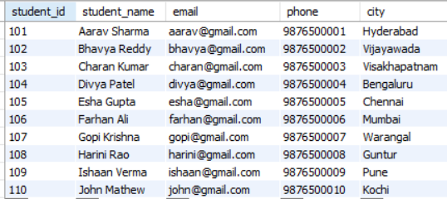
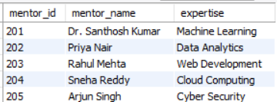
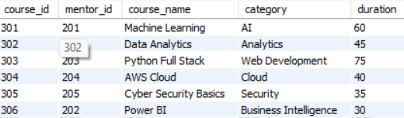
Sample Data

Slide 5
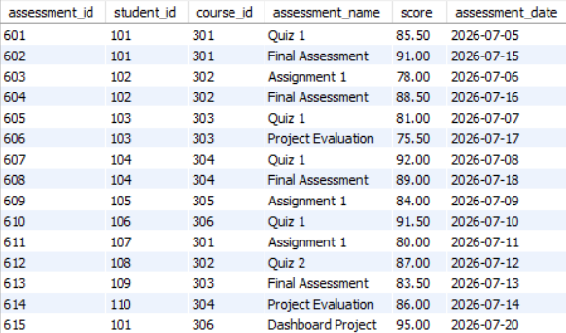
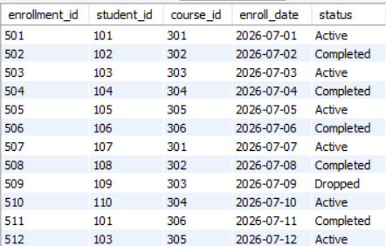
Sample Data

Slide 6
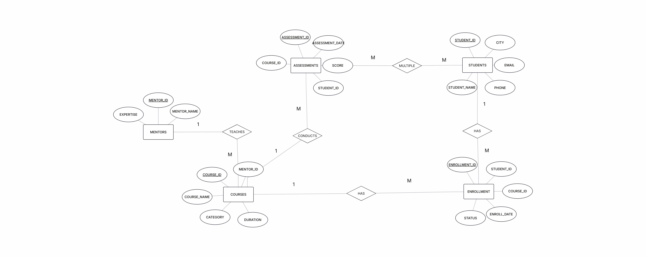
ER Diagram

Slide 7
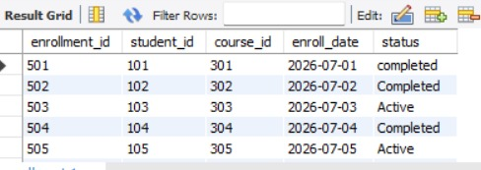
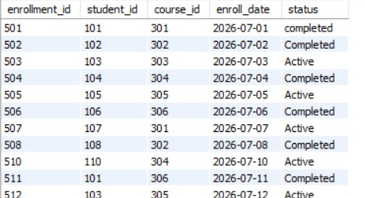
CRUD Operations
C – CREATE (INSERT) - Adds new records into tables.
R – READ (SELECT) - Retrieves records from tables.
SELECT * FROM Students;
U – UPDATE - Modifies existing records.
UPDATE ENROLLMENT SET STATUS = ‘COMPLETED’
WHERE STUDENT_ID = 101 AND STATUS = ‘ACTIVE’;
D – DELETE - Removes records from tables.
DELETE FROM ENROLLMENT
WHERE STATUS = ‘DROPPED’;

Slide 8
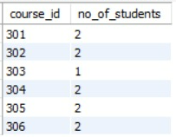
Aggregate Functions
Used to perform calculations on multiple rows and return a single result.
COUNT() – Counts the number of records.
SUM() – Calculates the total sum of values.
AVG() – Calculates the average of values.
MAX() – Returns the highest value.
MIN() – Returns the lowest value.
SELECT COURSE_ID,COUNT(STUDENT_ID) AS NO_OF_STUDENTS FROM ENROLLMENT GROUP BY COURSE_ID;

Slide 9
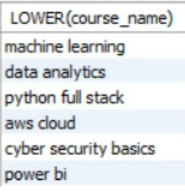
String Functions
Used to manipulate, modify, and transform text data stored in database columns.
UPPER() – Converts text into uppercase.
LOWER() – Converts text into lowercase.
SUBSTRING() – Extracts a portion of a string.
CONCAT() – Combines multiple strings.
REPLACE() – Replaces specified characters or words.
SELECT LOWER(COURSE_NAME) FROM COURSES;

Slide 10
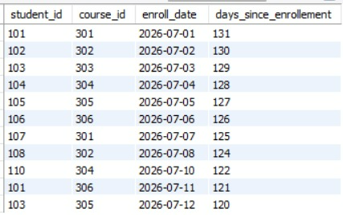
Date Functions
Used to retrieve, manipulate, format, and perform calculations on date values.
NOW() – Returns the current date and time.
CURDATE() – Returns the current date.
DATEDIFF() – Calculates the difference between dates.
DATE_FORMAT() – Formats a date into a specified format.
DAYNAME() – Returns the weekday name.
SELECT STUDENT_ID,COURSE_ID,ENROLL_DATE, DATEDIFF(CURDATE(),ENROLL_DATE) AS DAYS_SINCE_ENROLLEMENT FROM ENROLLMENT;

Slide 11
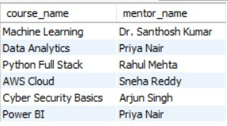
Joins
Used to combine data from two or more tables based on related columns.
INNER JOIN – Returns matching records.
LEFT JOIN – Returns all left records and matching right records.
RIGHT JOIN – Returns all right records and matching left records.
CROSS JOIN – Returns all possible combinations.
SELF JOIN – Joins a table with itself.
SELECT C.COURSE_NAME ,M.MENTOR_NAME FROM COURSES C INNER JOIN MENTORS M ON C.MENTOR_ID=M.MENTOR_ID;

Slide 12
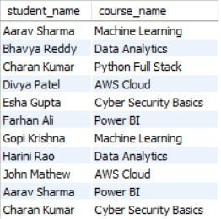
Multiple Joins
Multiple joins allow you to combine data from more than two tables in a single query.
SELECT S.STUDENT_NAME,C.COURSE_NAME FROM STUDENTS2 S INNER JOIN ENROLLMENT E ON S.STUDENT_ID=E.STUDENT_ID INNER JOIN COURSES C ON E.COURSE_ID=C.COURSE_ID;

Slide 13
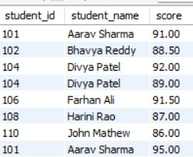
Sub Queries
A subquery is a query written inside another SQL query. The result of the inner query is used by the outer query.
Types
Single-Row Subquery – Returns one row.
Multiple-Row Subquery – Returns multiple rows.
Correlated Subquery – Depends on the outer query.
SELECT S.STUDENT_ID,S.STUDENT_NAME,A.SCORE FROM STUDENTS2 S INNER JOIN ASSESSMENTS A
ON S.STUDENT_ID = A.STUDENT_ID
WHERE A.SCORE>(SELECT AVG(SCORE)FROM ASSESSMENTS);

Slide 14
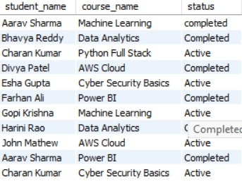
Views
Views are virtual tables created using SQL queries. They simplify complex queries and provide easy access to selected data.
CREATE VIEW STUDENT_COURSE_VIEW AS SELECT S.STUDENT_NAME, C.COURSE_NAME, E.STATUS FROM STUDENTS2 S
INNER JOIN ENROLLMENT E ON S.STUDENT_ID =E.STUDENT_ID INNER JOIN COURSES C ON E.COURSE_ID = C.COURSE_ID;
SELECT * FROM STUDENT_COURSE_VIEW;

Slide 15

TCL
Used to manage database transactions.
COMMIT – Permanently saves changes.
ROLLBACK – Undoes uncommitted changes.
SAVEPOINT – Creates a temporary rollback point.
START TRANSACTION;
UPDATE ENROLLMENT SET STATUS='COMPLETED’
WHERE ENROLLMENT_ID = 501;
COMMIT;

Slide 16
Stored Procedures
A stored procedure is a reusable SQL program stored in the database that can be executed whenever required.
CREATE DEFINER=`ROOT`@`LOCALHOST` PROCEDURE `GET_COURSES_BY_CATEGORY`(IN INPUT_CATEGORY VARCHAR(100))
BEGIN
SELECT *FROM COURSES WHERE CATEGORY=INPUT_CATEGORY;
END
CALL GET_COURSES_BY_CATEGORY('AI');

Slide 17
Triggers
A trigger is a database object that automatically executes when an INSERT, UPDATE, or DELETE operation occurs on a table.
CREATE TABLE Assessment_Log (assessment_id INT, student_id INT,course_id INT,assessment_name VARCHAR(100), score DECIMAL(5,2),assessment_date DATE);
CREATE DEFINER=`root`@`localhost` TRIGGER `After_Assessment_Insert` AFTER INSERT ON `assessments` FOR EACH ROW
BEGIN
INSERT INTO Assessment_Log (assessment_id, student_id, course_id, assessment_name, score, assessment_date) VALUES (NEW.assessment_id, NEW.student_id, NEW.course_id, NEW.assessment_name, NEW.score, NEW.assessment_date);
END
INSERT INTO Assessments VALUES (101, 5, 2, 'Python Test', 85.50, '2026-11-09’);
SELECT * FROM Assessment_Log;

Slide 18
Conclusion
The Learning Management System database provides an organized approach to managing students, mentors, courses, enrollments, and assessments. SQL operations help maintain records, track enrollment status, analyze assessment scores, and generate useful reports. The project demonstrates the practical implementation of database concepts such as CRUD operations, aggregate functions, joins, subqueries, views, transactions, stored procedures, and triggers.

Slide 19
Thank You

